Slide 1
12.0 Assignment
Download Home.png from the Google Classroom, before you start working on this project.

Slide 2
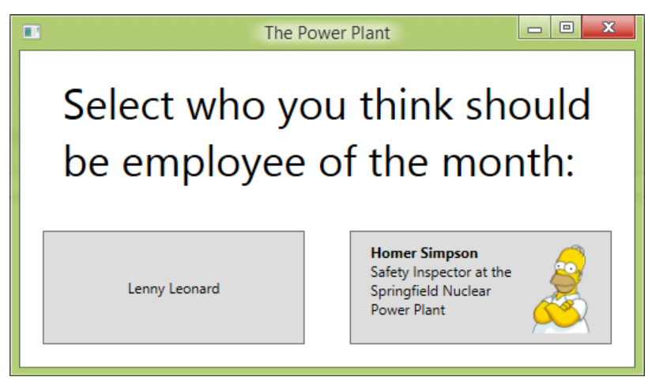
Exercise 1
Create a window with the two buttons as shown.
To improve the visual appearance of the button with Homer Simpson's name; modify Homer's button to get the result shown.
A good start would be to add a layout panel to the button's content (instead of the string "Homer Simpson") and then add child items to that layout panel

Slide 3

Exercise 2
When the user clicks any of the buttons, a dialog window is shown showing this message;
Thank you for choosing (Name of the employee you’ve chosen), as the employee of the Month!
With an OK and Cancel button underneath.

Slide 4
Thank you!
Ooko, 13th March 2019

